Slide 1
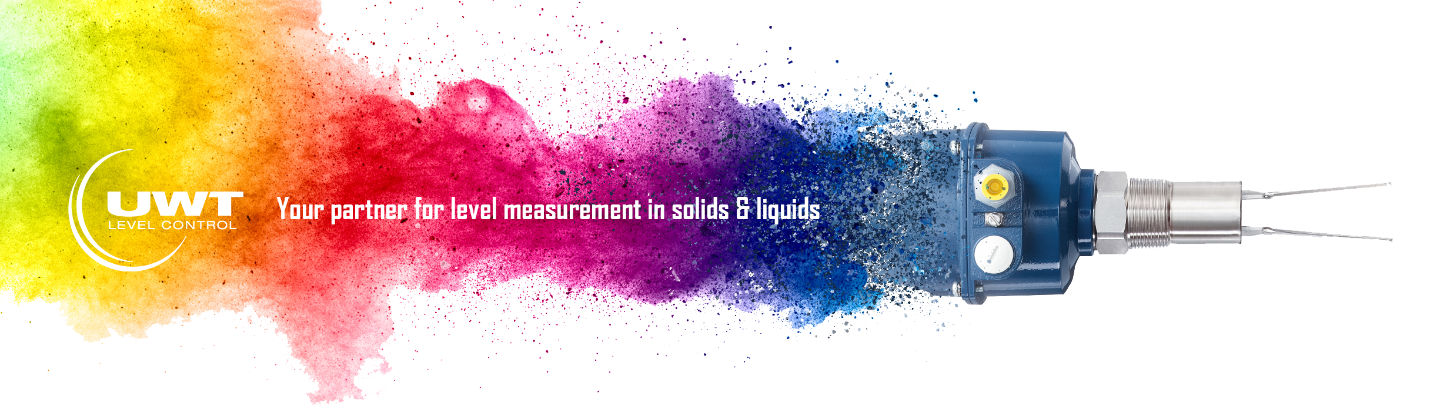

Vibranivo® - VN2000 Series | Vibration Level Switch
Point Level Detection
in Truck to detect cement powder level
The Vibranivo® - vibrating fork for point level measurement, with its robust stainless steel extension and high sensitivity, is widely used in storage silos and process vessels. The Vibranivo® vibration level switch is robust, easy to operate and can, via its series range, be precisely configured for each application. Electronically stimulated piezos cause the fork to vibrate. As soon as the sensor is covered with material, the vibration is dampened and the resulting electrical current change causes the output signal to switch. Once the material level falls below the sensor, it is free to vibrate again and the output signal is reset.
International approvals for use in hazardous locations (gas and dust).
The Challenge
Our Solution
Optimal Product Solution
A manufacturer of trucks for the cement industry looks for a reliable sensor to detect the max-level in the truck transporter. Different solids will be filled in this tanks. It should be a robust sensor for this harsh environment.
The vibrating fork VN2020 is an ideal solution with high sensitivity regardless of dusty environment and limited installation space. This sensor is robust, has a stainless steel probe and an aluminum diecast housing. The switch is a plug and play sensor and simple in installation and commissioning. Universal voltage electronic and no calibration.
VN 2020
Full, Demand, Empty Detector
Short version
Installation vertically, horizontally and oblique installation.
Compact extension length: 235 mm
High sensitivity from 5g/l
905-607-3240, Ext. 500 | 905-609-0192 | www.ratetechnologysystems.com | jonathan@ratetechnology.com | Book Online Meeting

Slide 2
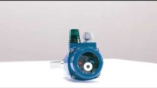
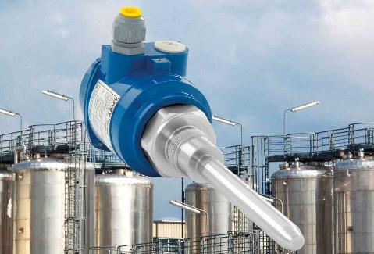

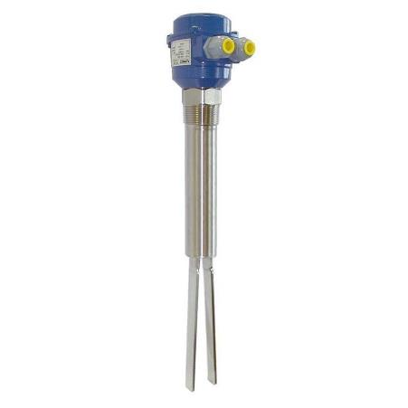
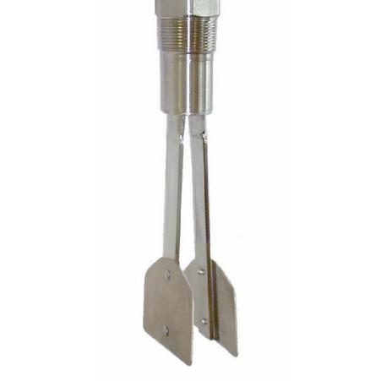
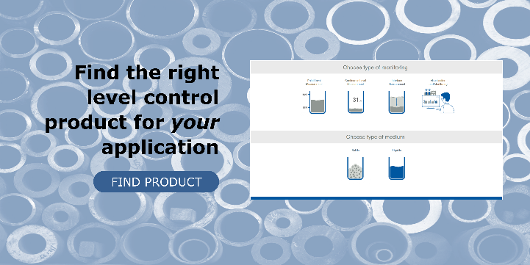
Vibranivo®
Vibration Fork Point Level Switch
Vibrating fork series for process solutions in different industries
>> Product Sheet
>> Technical Sheet
>> Vibranivo® Brochure
>> Submit Project Scope Online
>> Book Online Meeting
Application Area
The vibrating fork Vibranivo® VN 2020 is used in storage and process vessels as a full, demand, and empty detector in many dry and free flowing bulk solids. Due to its high sensitivity, the probe is particularly suitable for use in very light bulk solids. The high surface quality of the stainless steel probe also makes it ideal for use in applications with hygienic requirements.
Your Benefit
Maintenance-free sensor for use in many bulk materials.
Particularly suitable for very light bulk solids
Extension is completely made of stainless steel
Plug and play level limit switch without calibration

